Slide 1
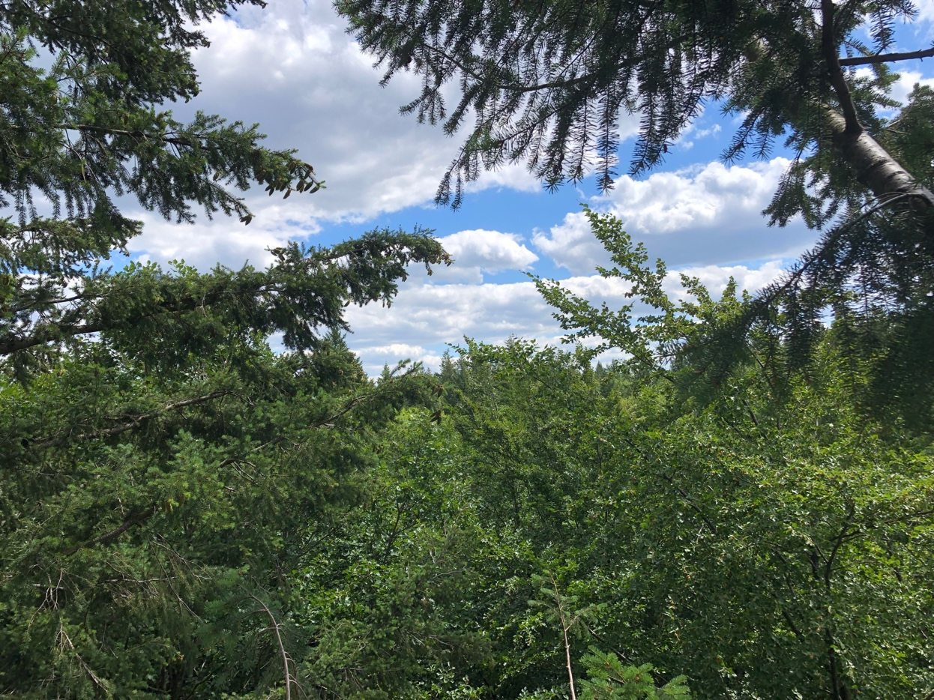
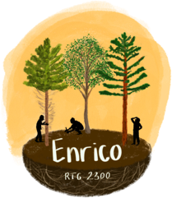


Plant hydraulics and Why should we study?
Sharath Paligi
17th June 2024

Slide 2
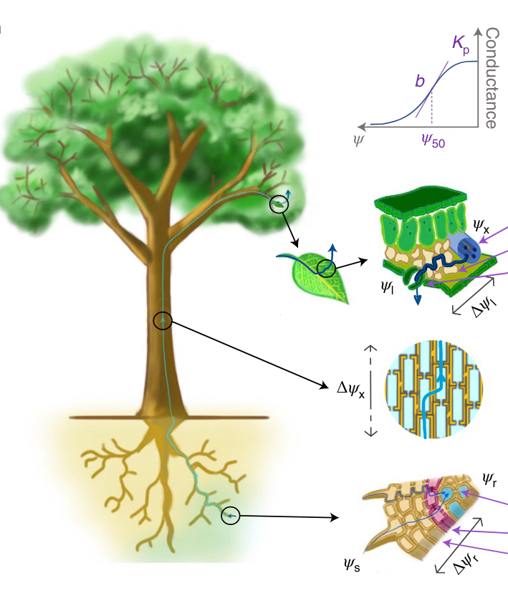
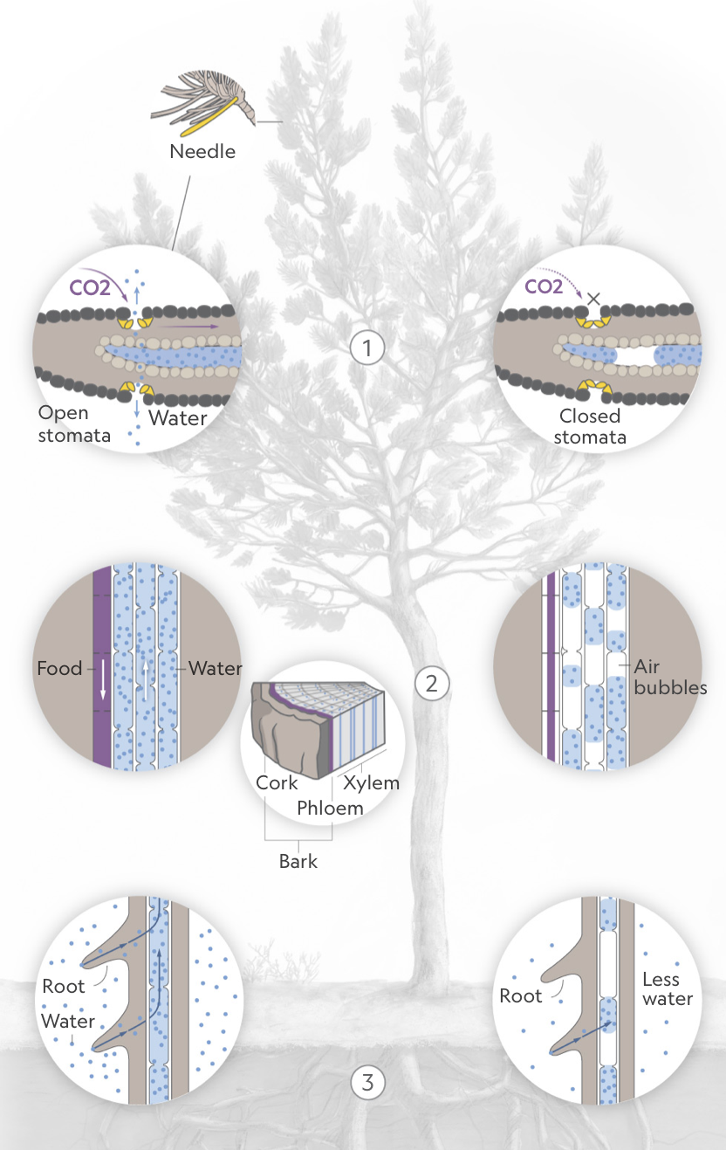

Water transport pathway
Joshi et al. 2022; Hammond et al. 2022

Slide 3
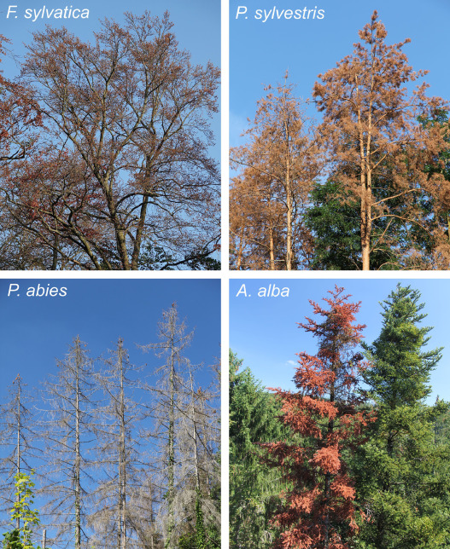
In Germany
Schuldt et al. 2020

Slide 4
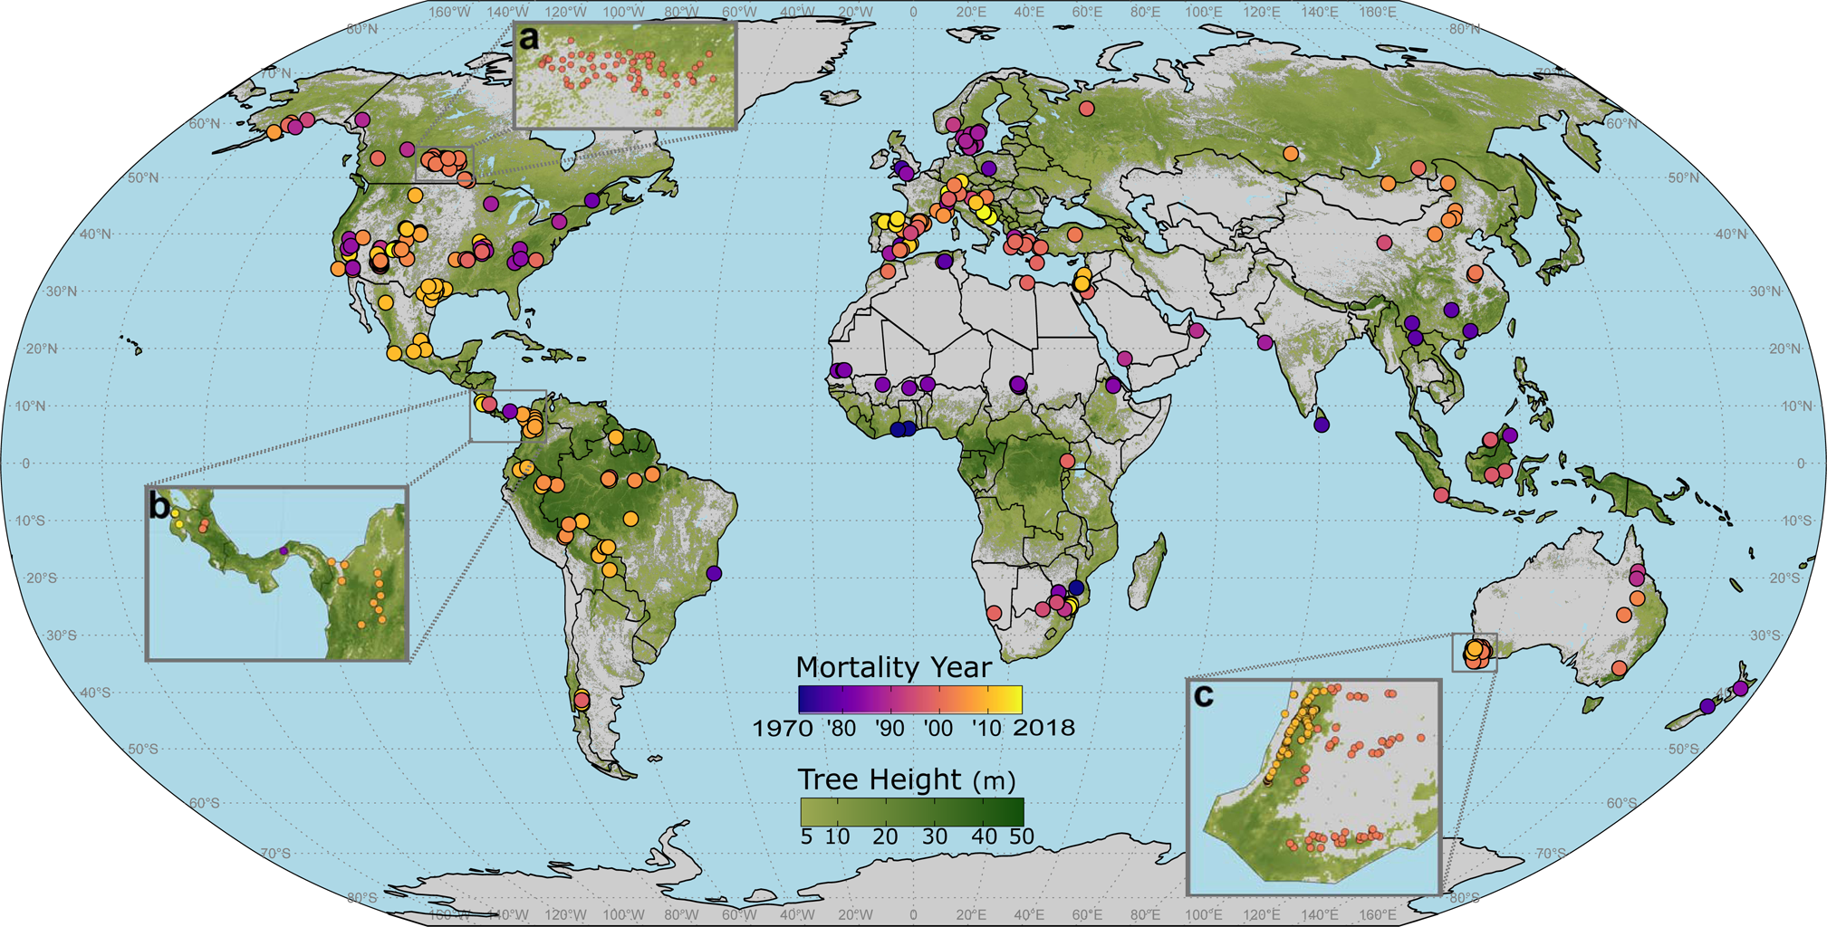
hotter-drought tree mortality
Hammond et al. 2022

Slide 5
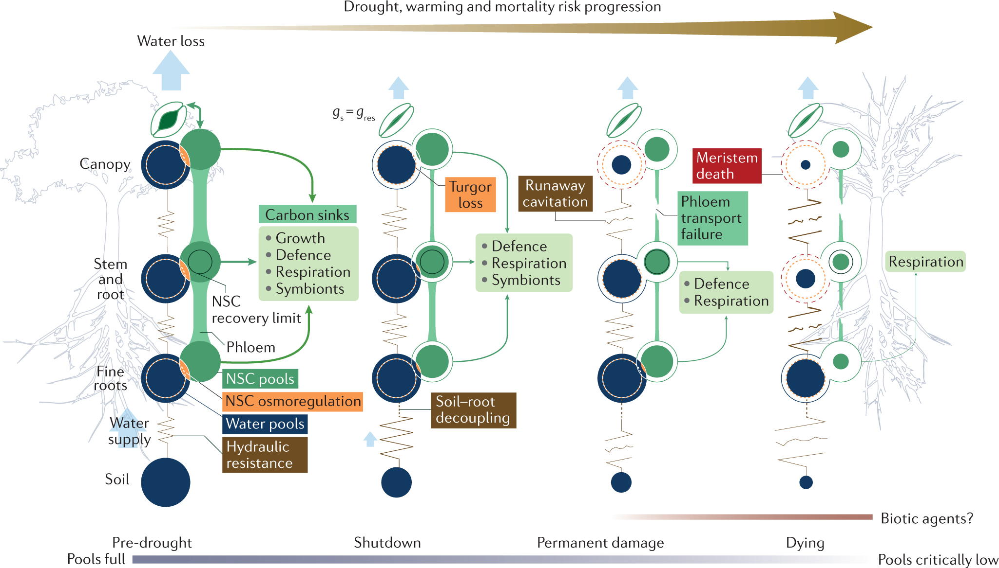
Tree mortality process
McDowell et al. 2022

Slide 6
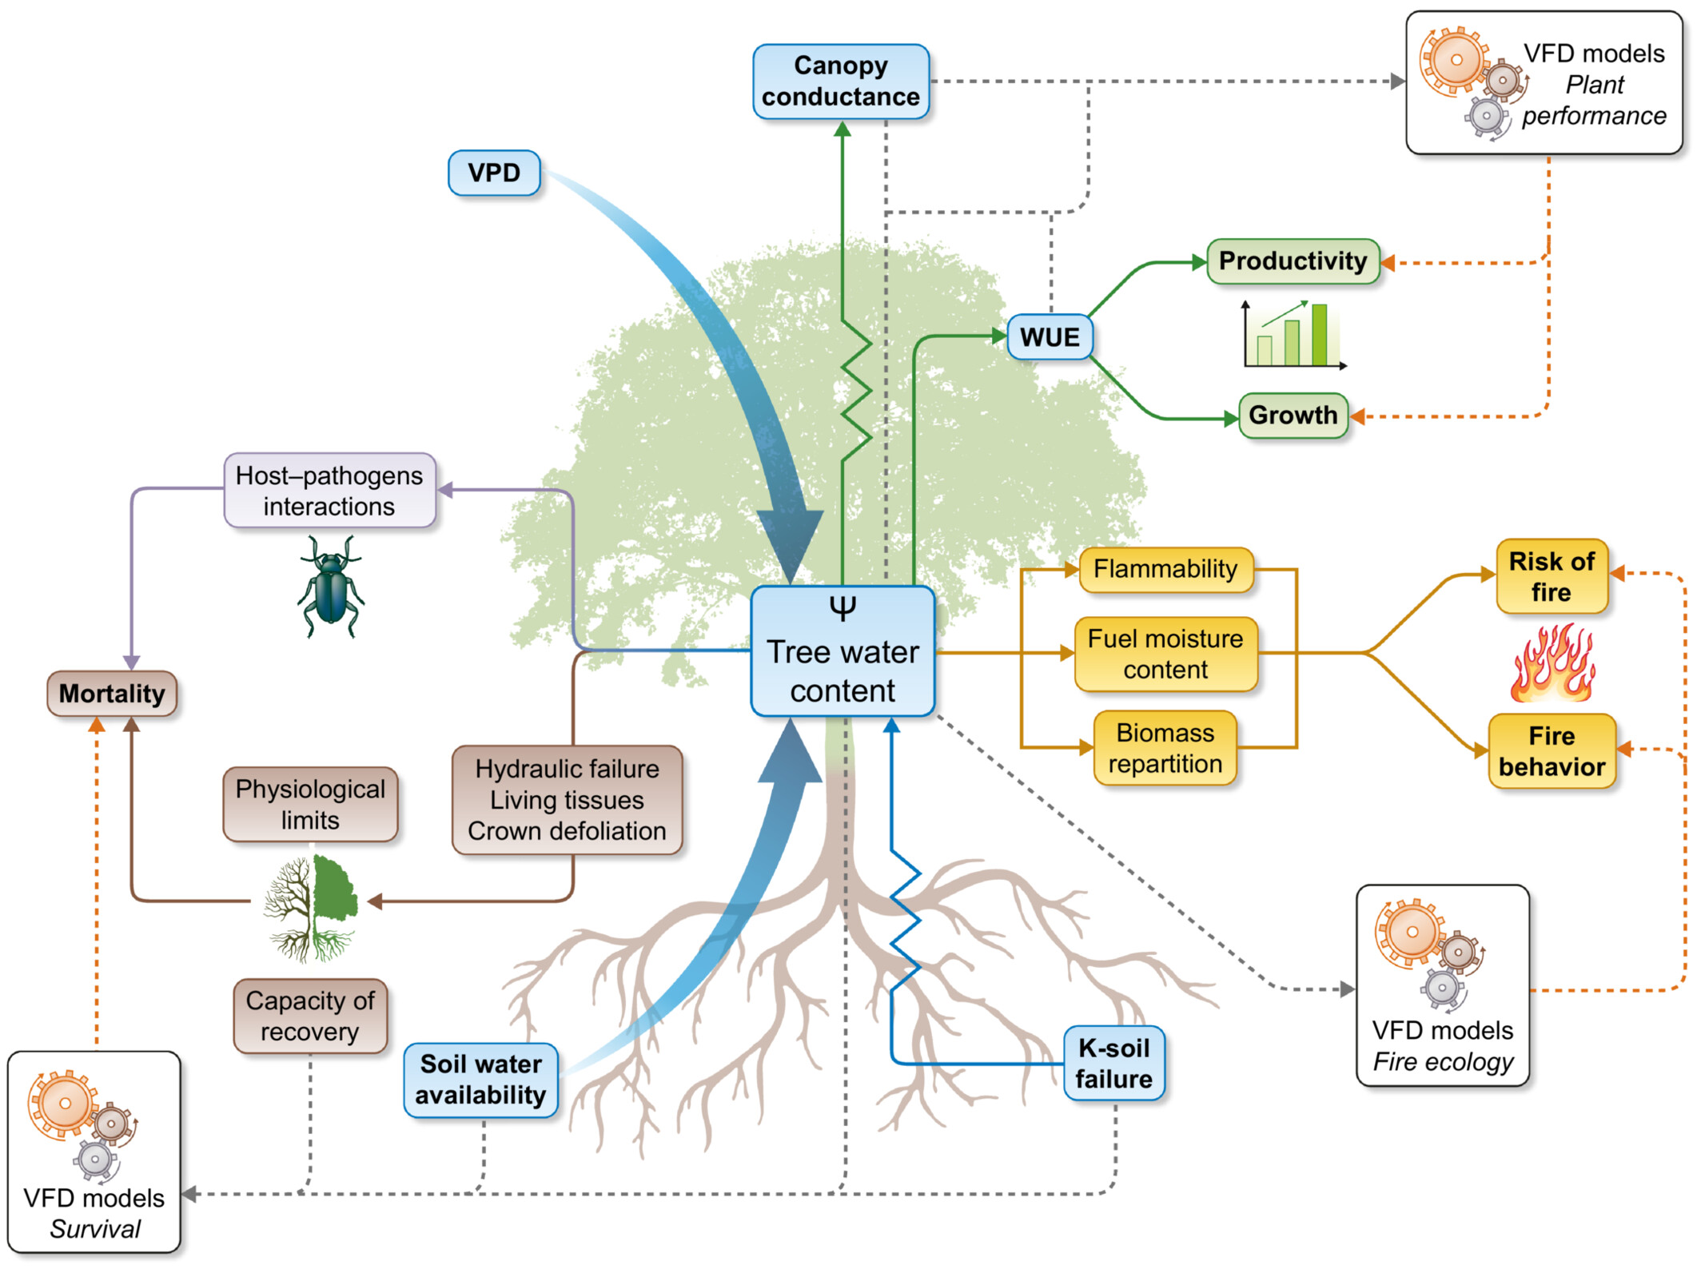
Complexity of the process
Torres-Ruiz et al. 2024

Slide 7
Challenges in studying plant hydraulics?
Complexity in measurements
Measurements
Time-intensive
Plasticity
Seasonal
Site-specific
Management specific…
Accessibility

Slide 8
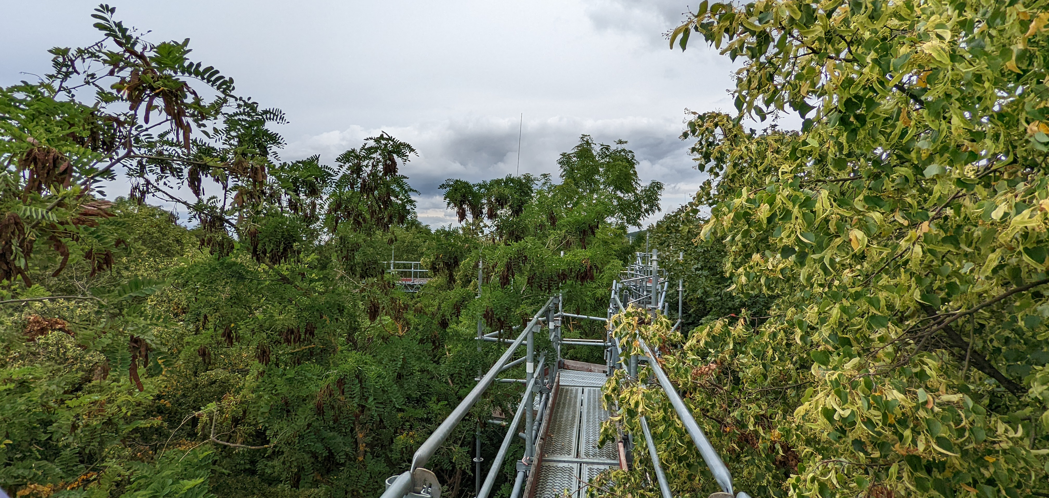
Our canopy walkway facility!

Slide 9
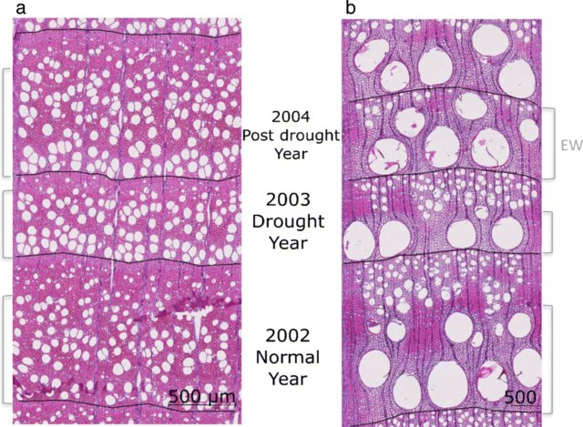
Species of interest
Tilia cordata
Acer platanoides
Robinia pseudoacacia
Fraxinus excelsior
Diffuse porous
Ring porous
Schwarz et al. 2020

Slide 10
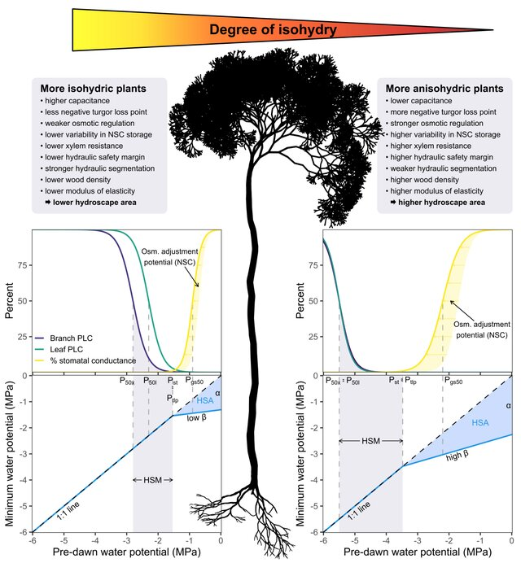
Water status regulation
Isohydric
Tilia cordata
Acer platanoides
Anisohydric
Robinia pseudoacacia
Fraxinus excelsior
Hartmann et al. 2020

